Slide 1
Attendance Area Presentation
Hillsdale Elementary
Victory Middle School
High School Attendance Areas

Slide 2

March 10, 2015 Bond

Slide 3
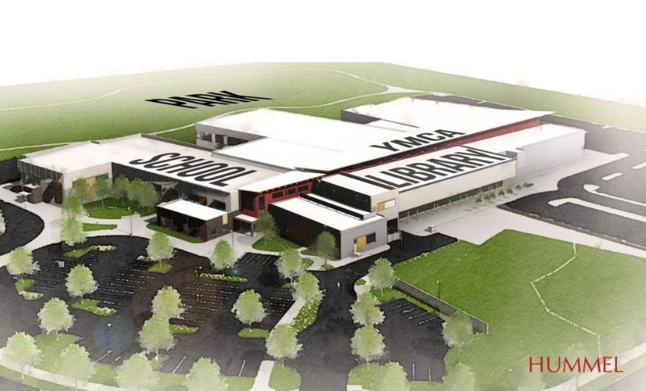
March 10, 2015 Bond Measure
Hillsdale Elementary: Fall 2016
Capacity 650
Cost: $14 million

Slide 4
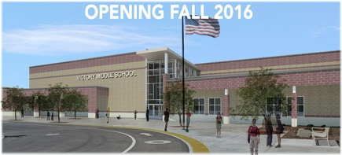
March 10, 2015 Bond Measure
Victory Middle School: Fall 2016
Capacity 1,000
Cost: $27 million
Star Middle School: Fall 2017
Capacity 1,000
Cost: $30 million (budgeted)

Slide 5
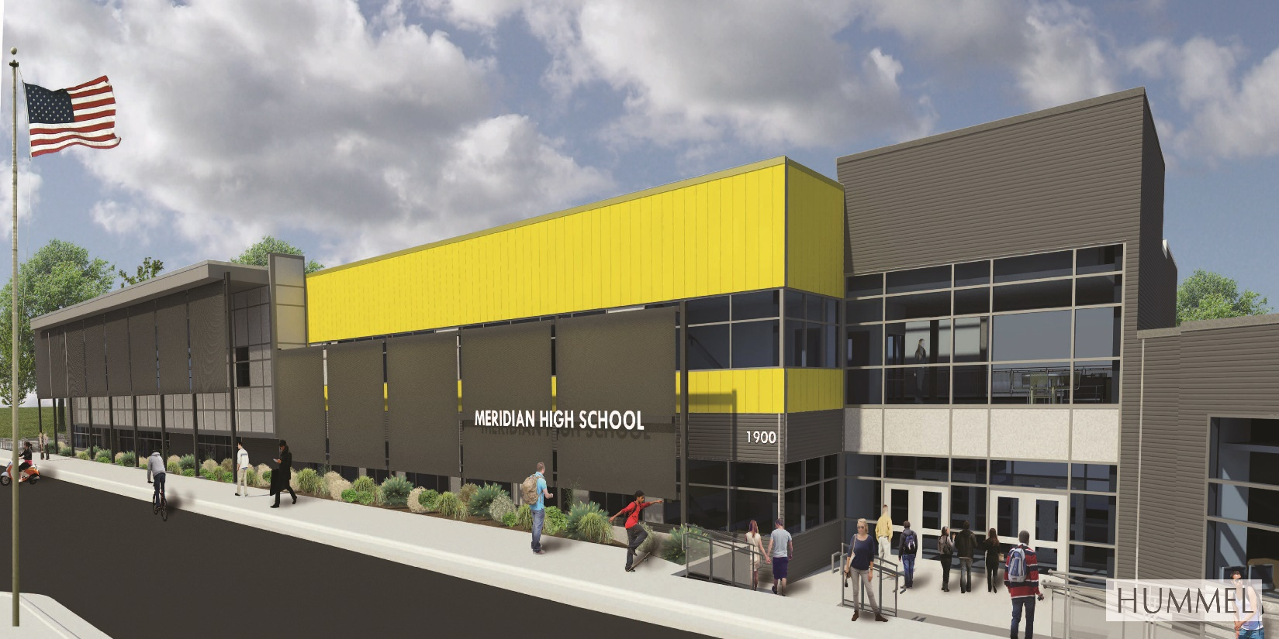
March 10, 2015 Bond Measure
Meridian High
Capacity 2400
Cost: $30 million ($20 bond; $10 plant facility)

Slide 6
Original Timeline
Proposed timeline
Community Informational Meetings
Three meetings in September
Attendance Area Committee Meetings
Wednesday, October 7 – Orientation to process
Wednesday, October 14 – Subcommittee proposals
Wednesday, October 21 – Subcommittee proposals
Wednesday, October 28 – Subcommittee proposals
Wednesday, November 4 – Subcommittee proposals
Wednesday, November 11 – Presentation of subcommittee proposals
Wednesday, November 18 – Reconciliation of subcommittee proposals
Wednesday, November 25 – Reconciliation of subcommittee proposals
Wednesday, December 2 – Preparation of final proposal
Public Presentations of Boundary Proposal
Mountain View High School Auditorium, 7 PM – Wednesday, December 9
Meridian High School Cafeteria, 7 PM – Wednesday, December 16
Eagle High School Auditorium, 7 PM – Wednesday, January 6
Presentation to Board of Trustees
Tuesday, January 26

Slide 7
Current Timeline
Wednesday, December 2: High School Boundaries (7 pm – 10 pm)
Wednesday, December 9: Present proposals to Alternate Attendance Area Committee
Monday, December 14: Reconcile attendance area proposals
Wednesday, December 16: Reconcile Attendance area proposals
Monday, January 4: Reconcile attendance area proposals
Wednesday, January 6: Public Hearing, Mountain View, 7 PM
Thursday, January 7: Committee meeting to consider changes to the proposal
Wednesday, January 13: Public Hearing, Meridian Middle School Auditorium, 7 PM
Wednesday January 14: Committee meeting to consider changes to proposal
Wednesday, January 20: Public Hearing, Rocky Mountain High School, 7 PM
Thursday, January 21: Committee meeting to prepare for presentation to Board of Trustees
Presentation to Board of Trustees: Tuesday, February 9 (tentatively Meridian Middle School)

Slide 8
Considerations
Balance enrollment and reduce overcrowding
Neighborhood continuity
Safety issues (busy roads, canals, etc)
Distance (walking students, busing, etc)
Current students versus future growth
“Bouncing” students
Feeder schools (middle school attendance zones)

Slide 9
Proposed boundaries discussion:
Hillsdale Elementary School
Challenges and Considerations
Students within the square mile where Siena Elementary is located are walking students
Students in Thousands Springs are in walk zone
No students can walk to Hillsdale Elementary
Mary McPherson is 100 students over capacity
Siena is 150 students over capacity
Geographic distance made it difficult to relieve overcrowding at Silver Sage Elementary

Slide 10
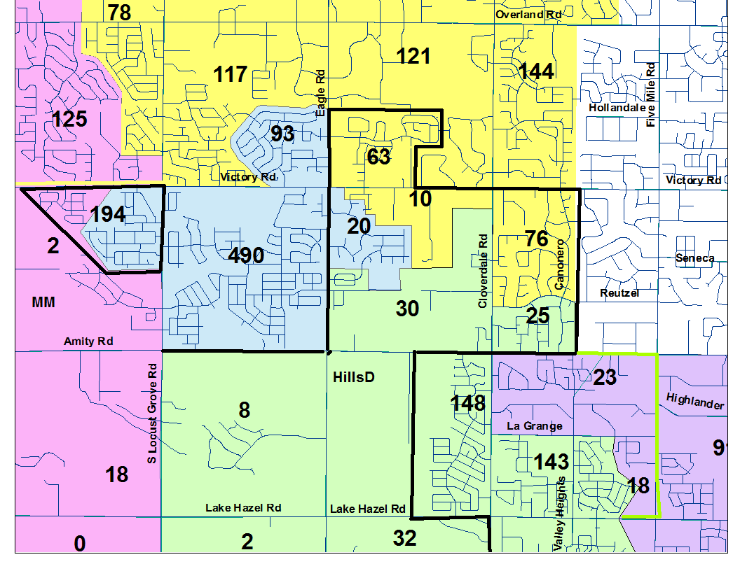
Hillsdale Elementary School Proposal
Resulting Enrollment
Mary Mac: 374/Capacity 430
Siena: 583/Capacity 650
Pepper Ridge: 579/Capacity 650
Hillsdale: 460/Capacity 650
Lake Hazel: 459/Capacity 450

Slide 11
Considerations
Balance enrollment and reduce overcrowding
Mary Mac, Siena, Pepperidge, Hillsdale, Desert Sage at or under capacity
Lake Hazel Elementary 9 students over capacity
Neighborhood continuity
Moves a disconnected subdivision into Hillsdale
Safety issues (busy roads, canals, etc)
None discussed
Distance (walking students, busing, etc)
339 students travel further than current schools
Furthest students are 2.0 miles from Hillsdale
Current students versus future growth
Provides 190 seats for future growth at Hillsdale
250 students anticipated from Century Hills Subdivision
“Bouncing” students
Based on that growth estimate enrollment will exceed capacity with the completion of Century Farms by 60 students.
Feeder schools (middle school attendance zones)
49% go to Lake Hazel
51% go to Victory
Disconnected subdivisions have created feeder problems in other parts of West Ada School District

Slide 12
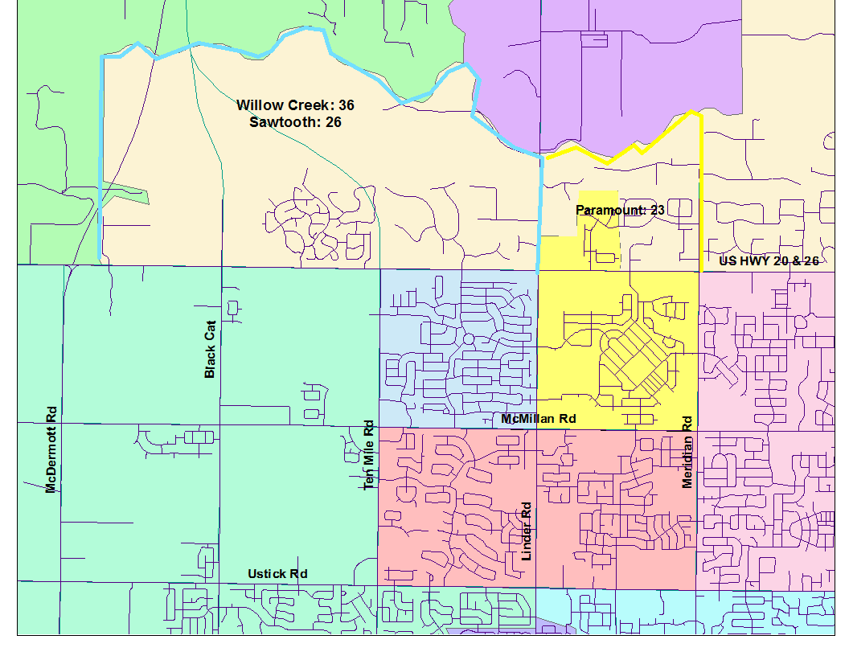
Proposal Change to Andrus Elementary Attendance Area
Fixes three-way middle school split
Relieves overcrowding at Heritage Middle School
Willow Creek: 522/Capacity 650
Paramount: 581/Capacity 650
Sawtooth: 1018/Capacity 1,000
Heritage: 1.174/Capacity 1,000

Slide 13
Proposed boundaries discussion:
Victory Middle School
Challenges and Considerations
Balancing enrollment
Aligning elementary school attendance areas with middle school attendance areas
Aligning middle school attendance areas with high school attendance areas

Slide 14
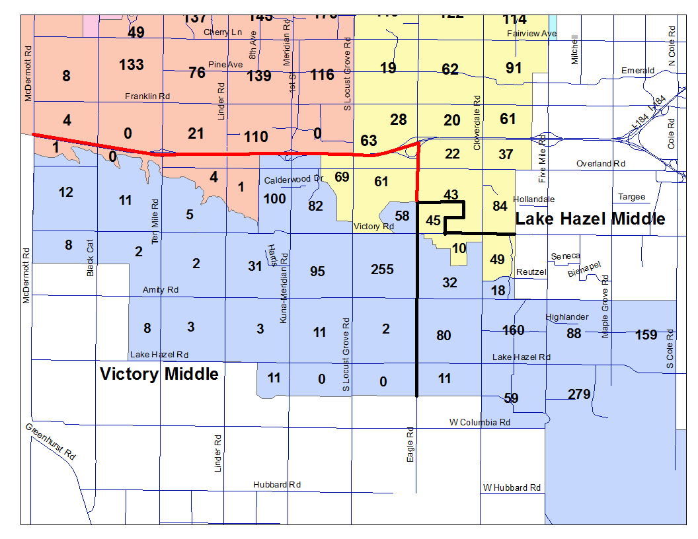
Victory Middle School Proposal
Resulting Enrollment
Lake Hazel: 990/Capacity 1,000
Victory: 835/Capacity 1,000
Lewis & Clark: 875/Capacity 1,000

Slide 15
Considerations
Balance enrollment and reduce overcrowding
Lake Hazel 10 under capacity
Victory 160 under capacity
Lewis and Clark 178 under capacity
Neighborhood continuity
Keeps major subdivisions together
Safety issues (busy roads, canals, etc)
Eagle Road is a natural barrier
Distance (walking students, busing, etc)
23 students travel further than current schools
Furthest students are 4.7 miles from Victory
Current students versus future growth
160 seats for future growth at Victory
290 additional students from current preliminary plates
10 seats for future growth at Lake Hazel
237 additional students from current preliminary plates
261 seats for future growth at Lewis and Clark
69 additional students from current preliminary plates
“Bouncing” students
Additional middle schools will need to be built south of I-84
Feeder schools (high school attendance zones)
See following high schools maps

Slide 16
Proposed boundaries discussion:
High School
Challenges and Considerations
Balancing enrollment
Aligning middle school attendance areas with high school attendance areas
The size difference between the current high school class (9-11) compared to the high school class in 2017 (7-10 grade students)
A desire to not over-enroll Meridian High
The need to use available space at Centennial High School
Future enrollment
Input from residents in many geographic areas about changes to the attendance areas

Slide 17
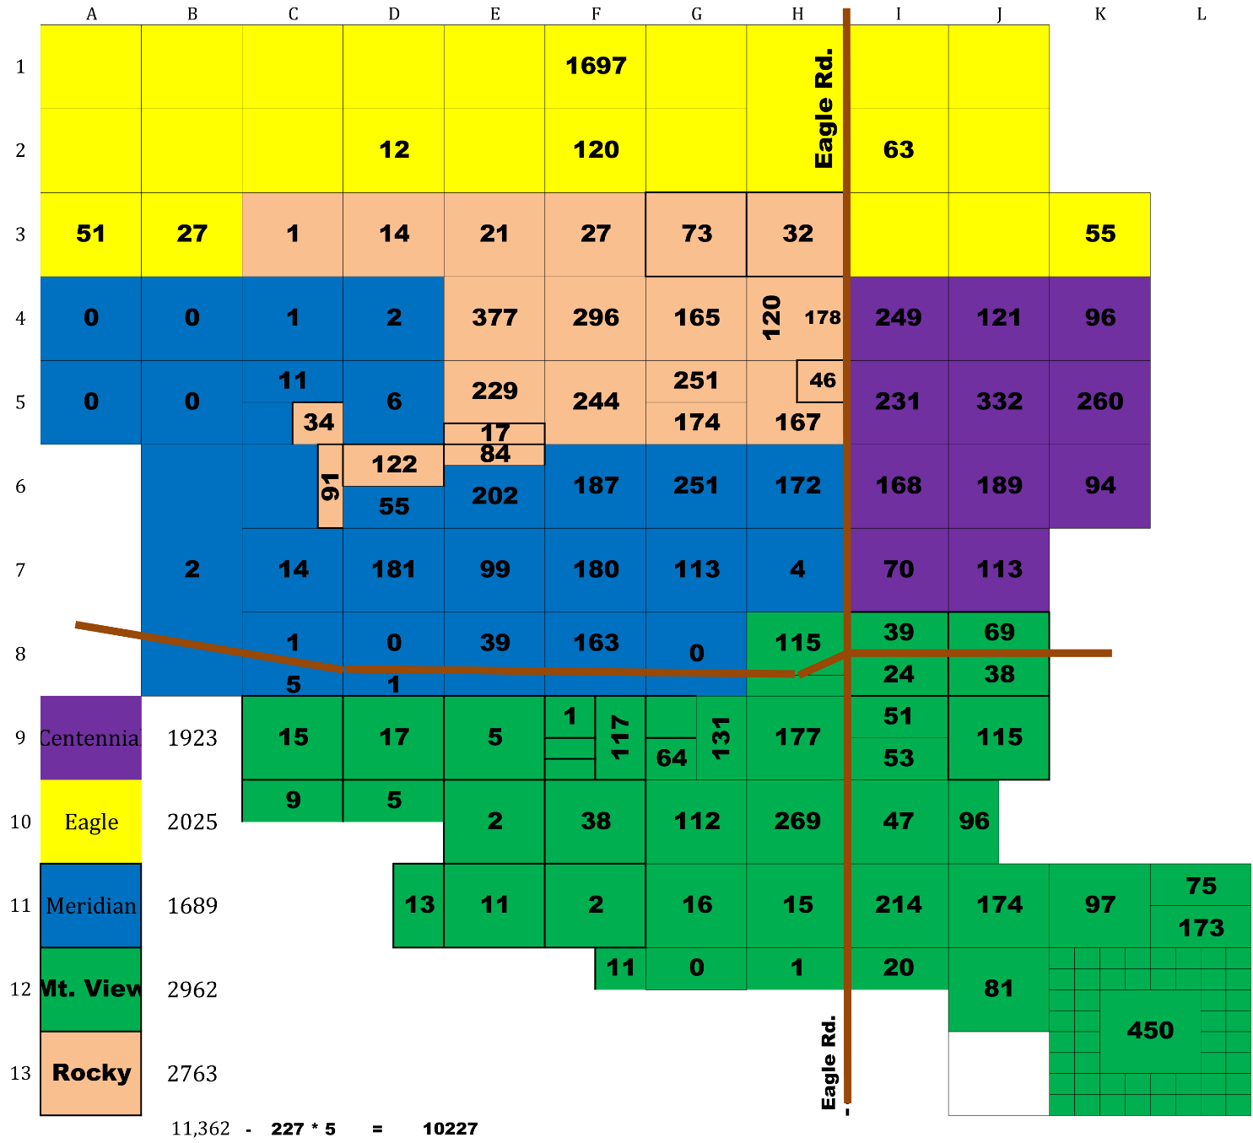
High School Over Enrollment
CHS: 1923
EHS: 2025
MHS: 1689
MVHS: 2962
RMHS: 2763

Slide 18
High School Over Enrollment
Cap Current 7th – 10th Centennial 1900 1768 1923
Eagle 1800 1817 2025
Meridian 2400 1555 2689
Mtn. View 1800 2382 2962
Rocky Mtn 1800 2332 2763
Total 9700 9854 11362
Students in excess of school capacity (1662)
Students lost to other programs: 1136
Students in excess of capacity: 526

Slide 19
Enrollment in other programs
Program | Number of Students | Year
Renaissance | 200 | 2016-17
 | 200 | 2017-18
Medical Arts | 50 | 2016-17
 | 50 | 2017-18
Technical Charter | 50 | 2016-2017
 | 50 | 2017-2018
Academy | 120 | 2016-2017
 | 120 | 2017-2018
Leave System | 148 | 2016-2017
 | 148 | 2017-2018
Total | 1136
Divided by 5 high schools: 227 students per high school

Slide 20
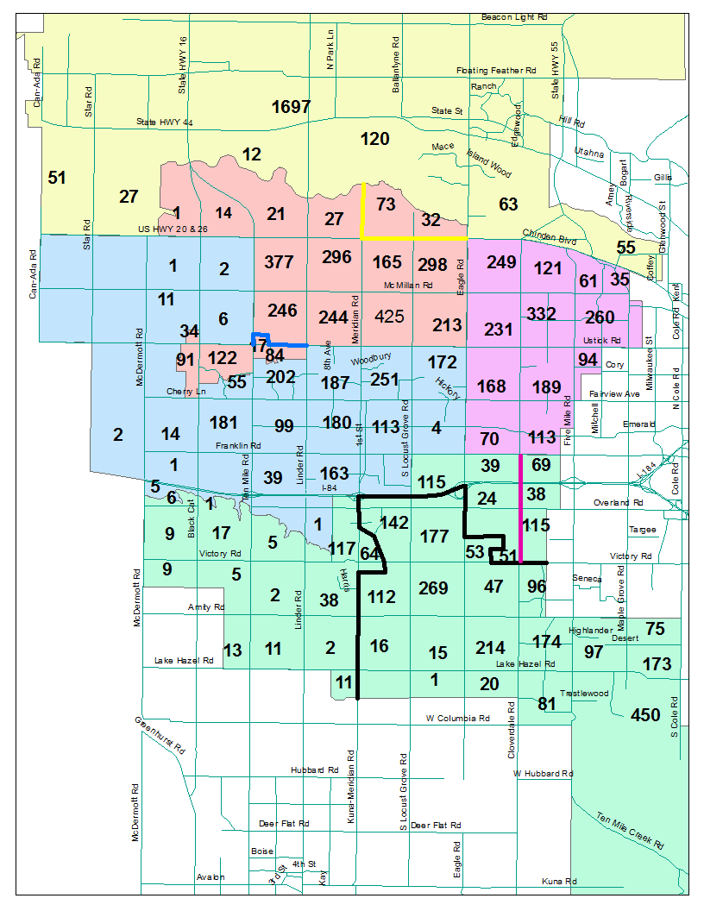
High School Proposal

Slide 21
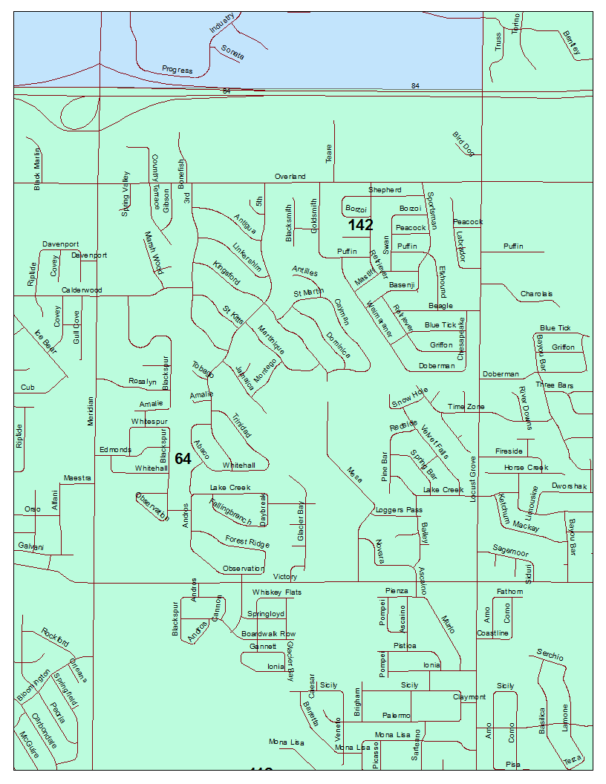
Proposal Details: Mountain View Walk Zone

Slide 22
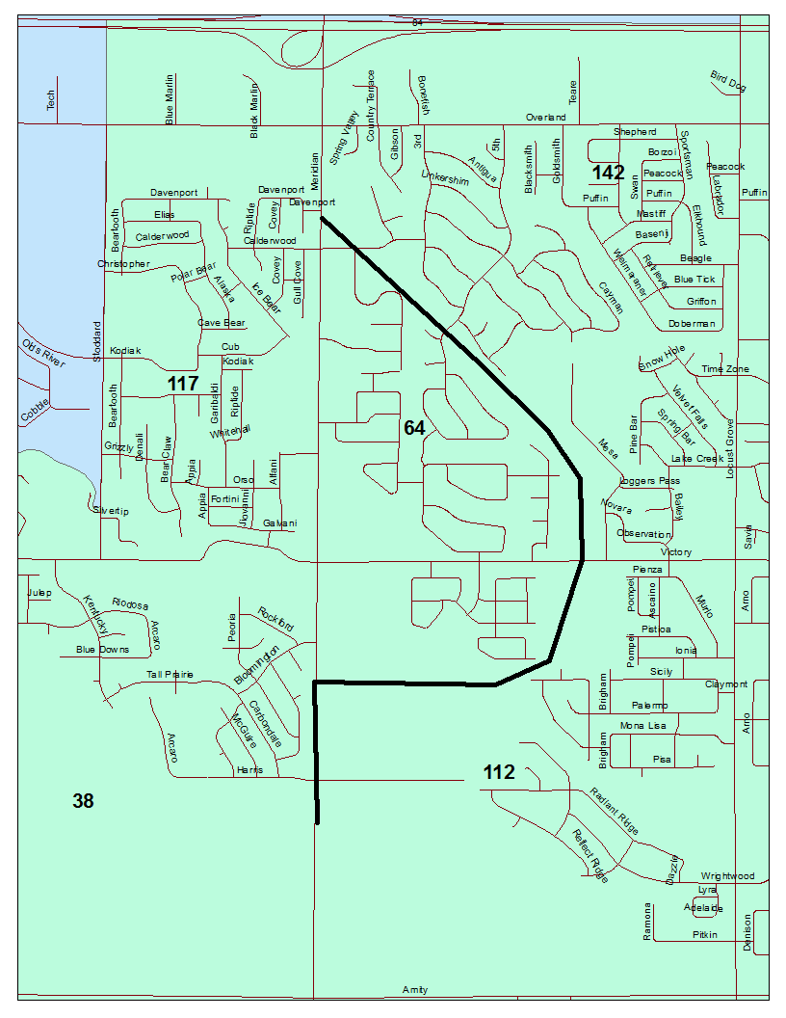
Proposal Details: Mountain View Walk Zone

Slide 23
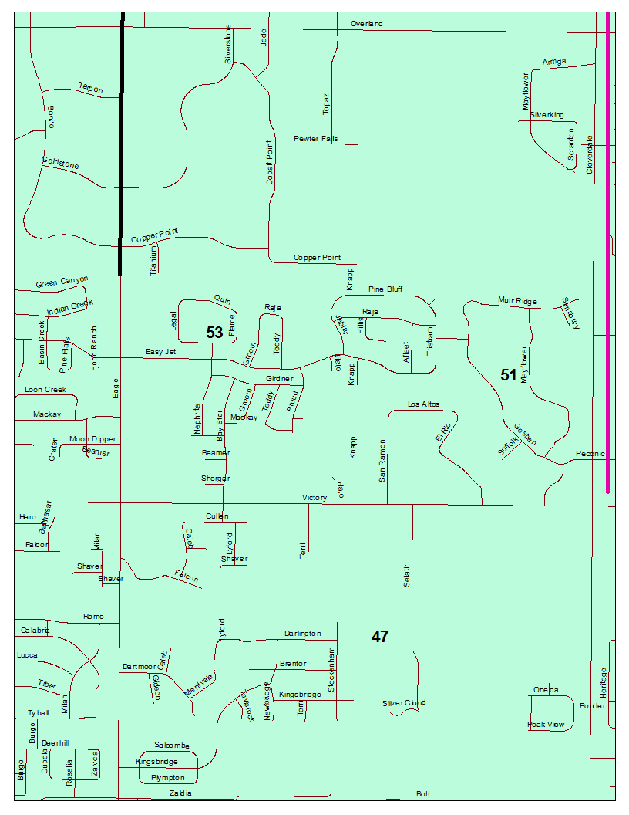
Proposal Details: Mountain View Walk Zone

Slide 24
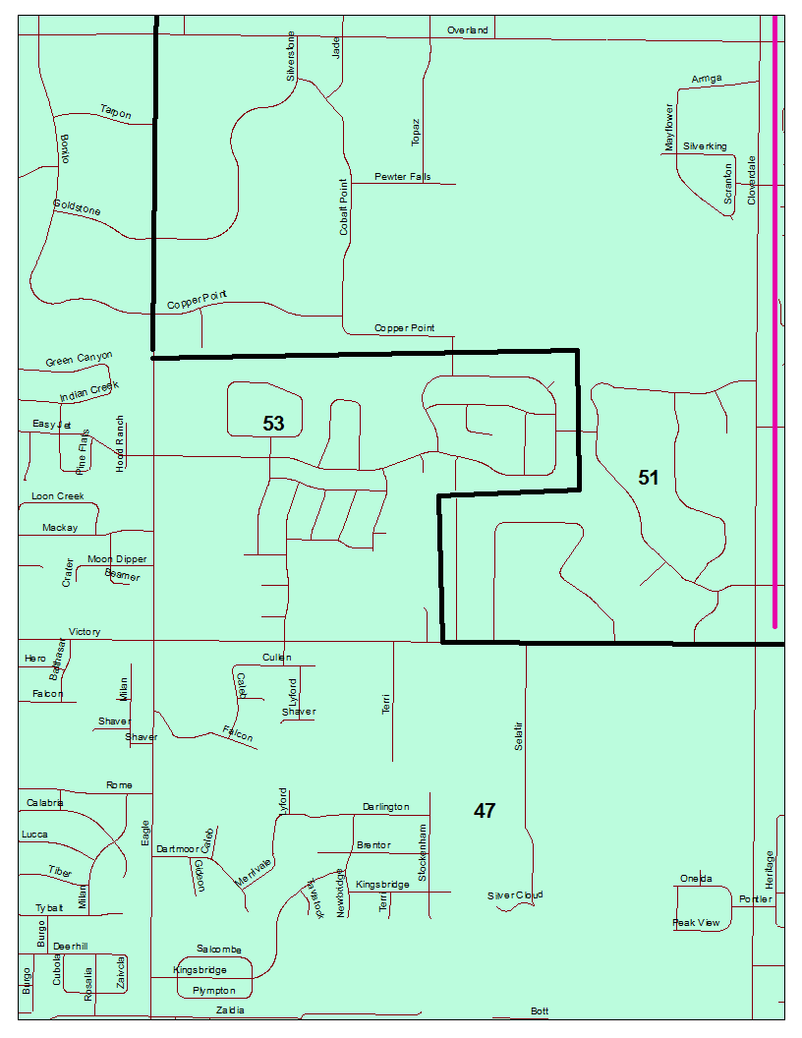
Proposal Details: Mountain View Walk Zone

Slide 25
Considerations
Balance enrollment and reduce overcrowding
Centennial High: 2145 – 13% over capacity
Eagle High: 2130 – 18% over capacity
Meridian High: 2576 – 3% over capacity
Mountain View: 2201 – 22% over capacity
Rocky Mountain: 2310 – 28% over capacity
To achieve equal enrollment, all schools would be 17% over capacity.
Neighborhood continuity
The areas that were drawn to help balance enrollment and preserve walk zones disrupt neighborhoods in some way
Safety issues (busy roads, canals, etc)
Meridian Road was discussed
the Ten Mile and Meridian overpass have had significant improvements.
Crossing Meridian Road was also considered.

Slide 26
Distance (walking students, busing, etc)
Mountain View
210 students West of Meridian Road move to a more distant school
The average increase in distance is 1.5 miles
Students west of 10 mile and North of Amity are closer to MHS that MVHS
The students south of Lake Hazel are 5.0 miles from MVHS (10 min); the distance to MHS is 6.6 miles (12 min)
400 students in the Cloverdale area are moved to a more distant schools
The students east of Cloverdale and south of Overland are 4.0 miles from MVHS; they are 6.3 miles from CHS
Students north of I-84 travel about 1.5 miles further

Slide 27
Distance (walking students, busing, etc)
Rocky Mountain
105 students north of Chinden move to a more distant school
The students north of Chinden nearest to Rocky Mountain are 2.5 miles from RMHS; they are 4.9 miles from Eagle High School
The students south of Ustick closest to RMHS are 2.3 miles away; they are 2.6 miles from MHS
The students south of Ustick furthest from RMHS; they are 2.1 miles from MHS

Slide 28
Current students versus future growth
0 Seats for future students at Mountain View
661 additional students from current preliminary plates
0 Seats for future students in Meridian High:
1,125 additional students from current preliminary plates
0 seats for future growth at Eagle High
1,139 additional students from current preliminary plates
0 seats for future growth at Centennial High
111 additional students from current preliminary plates
“Bouncing” students
Additional high schools will need to be built

Slide 29
Feeder schools
Four middle schools’ attendance zones are split between two high schools.
Lewis and Clark Middle School
33% would attend Meridian High School
67% would attend Centennial High School
Sawtooth Middle School
26% would attend Meridian High School
74% would attend Rocky Mountain High School
Victory Middle School
31% would attend Meridian High School
69% would attend Mountain View High School

Slide 30
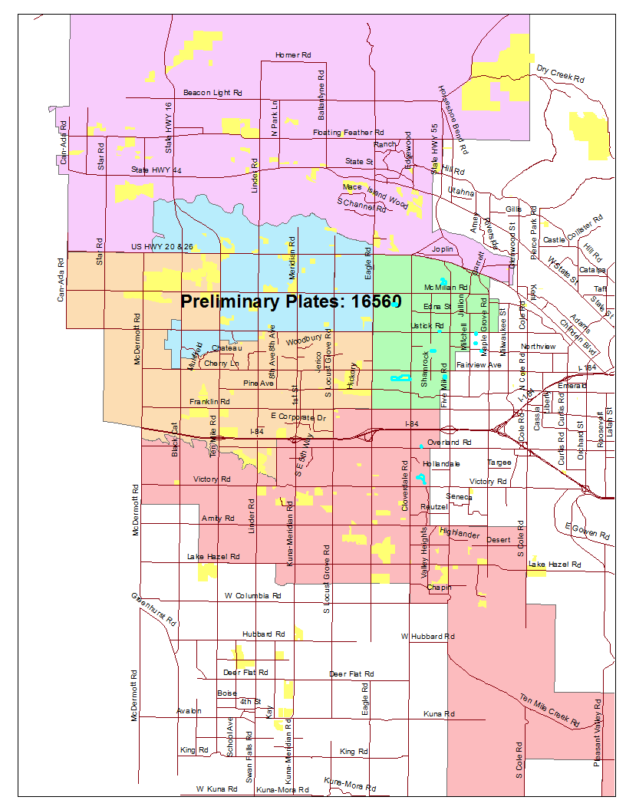
Projecting the Future

Slide 31
Growth Projections
16,560 plates will generate 13,248 students grades k-12, 1019 students per grade.
(based on 2010 US Census average students per household)
Based on the past 5 years growth rate, this total enrollment increase will take 26 years (500 new students per year).
Based on the district’s 20 year average growth rate, this total enrollment increase will take 13 years (1,000 students per year).
Current Student Cohorts
The current attendance area process has worked using current students in grades 7-10.
Lower grade cohorts have similar class sizes, ranging from 2789 students (1th grade) to 3023 students (3rd grade).
The only grades outside of this range are grades 11 (2732 students) and 12 (2467).
As a result, every 4-grade cohort generates about 11,600 students
Increased enrollment will not be the result of current students

Slide 32
Growth Projections
High School Enrollment Increases
At historic rates of enrollment increase (1,000 students per year), high school enrollment will increase by 313 students per year
(13,248/13 grades/13 years X 4 grades (9-12)
At this rate, in 5.7 years enrollment would exceed capacity by 1,800 students.
To meet this demand, a bond measure that includes a high school would need to be run in 2018 to allow for the 3-year timeline to construct a new high school
At the more recent enrollment rates (500 students per year) high school enrollment will not exceed capacity by an entire high school until 2027.
The district could propose a bond measure prior to enrollment exceeding capacity in an amount equal to the capacity of a new high school.

